Slide 1
Weighted moving average charts for detecting small shifts in process mean or trends
The wonders of JMP
<number>
Notes:
<number>

Slide 2
Shifts in the Process Mean and process knowledge
The X-bar chart is designed to detect changes in the Process Mean. In a mature Process, there may be a body of Process knowledge which suggests which types of changes in the Process Mean are likely to occur. this can be important in finding ways to detect relatively small changes in the mean which the four rules are unlikely to detect.
<number>

Slide 3
Sustained changes in the Process Mean
Experience has shown that there are two common types of sustained changes in the Process Mean:
A sustained shift in the Process Mean to a new value.
Slow trending in the Process Mean up or down.
<number>

Slide 4
Moving Average Charts
There are two types of Moving Average charts designed to be sensitive to these types of Process Mean changes:
The Uniformly Weighted Moving Average Chart, UWMA chart, (also known as the Arithmetic Moving Average chart, AMA chart)
The Exponentially Weighted Moving Average chart, EWMA chart, (also known as the Geometric Moving Average Chart, GMA chart)
<number>

Slide 5
Which to use?
Each of the two is to be used depending on the type of Process change one wishes to detect:
For a sustained shift in the Process Mean to a new value, use the Uniformly Weighted Moving Average chart.
For a slowly trending Process Mean, use the Exponentially Weighted Moving Average chart.
<number>

Slide 6
Moving Average charts in JMP
Each point on a Uniformly Weighted Moving Average (UWMA) chart, also called a Moving Average chart, is the average of the w most recent subgroup means (called “span”), including the present subgroup mean. These are often referred to as Arithmetic Moving Average (AMA) charts. These are often used in detecting a consistent shift in the Process Mean rapidly.
<number>

Slide 7
JMP control limits
If we assume the sample sizes in each subgroup are equal, then:
and so the three sigma limits for n subgroups (or spans) will be:
<number>

Slide 8
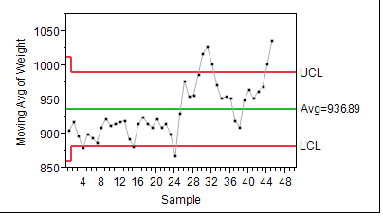
For first 45 data points of Example 6.7 in the text (using subgroups of size two)
<number>

Slide 9
Note:
At time point one, there is only one point so that the limits are wider here.
At all other time points the limits are divided by the square root of 2 and so are narrower.
<number>

Slide 10
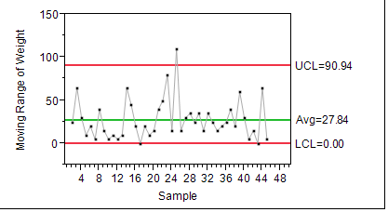
Compare to the XmR chart for the same data:
<number>

Slide 11
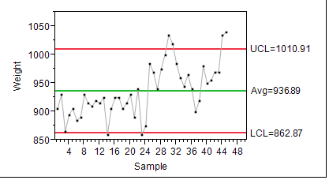
The Individuals Chart:
<number>

Slide 12
Example 6.7 data with span of two:
<number>

Slide 13
Note:
The Moving Average chart picked out subgroup 4 as out of control due to the tighter limits.
The Individuals Chart showed that subgroup was in control (though near the limits).
The Individuals Chart did show why the Range chart was out of control at time 25.
<number>

Slide 14
One can specify different “moving average spans”.
Moving average span is JMP talk for the number of subgroups to average over.
Let’s look at a moving average span of three.
Notice what happens to the limits.
<number>

Slide 15
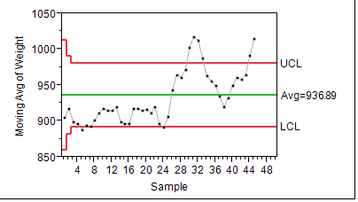
Example 6.7 data with span of three:
<number>

Slide 16
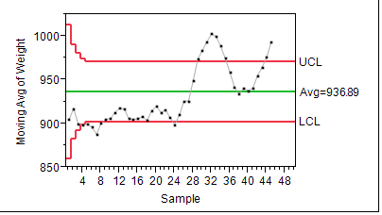
With span of five:
<number>

Slide 17
Properties of spans
The larger the span the tighter the limits.
For larger spans, averaging is done over more time points so short occurrences of Special Cause may be averaged out.
Larger spans may take longer to detect a shift in the mean, this depends of the size of the shift relative to Common Cause.
Experience is the best guide for span size.
<number>

Slide 18
Exponentially Weighted Moving Average Charts in JMP
Each point on an Exponentially Weighted Moving Average (EWMA) chart, also referred to as a Geometric Moving Average (GMA) chart, is the weighted average of all the previous subgroup means, including the mean of the present subgroup sample. These are very useful in detecting trends since the most recent points receive the greatest weight.
<number>

Slide 19
EWMA charts and weights
EWMA charts are formed by choosing a weight parameter r, which is a number between 0 and 1.
The value of r is the weight given to the most recent data point.
For subgroup size=1, a value of r=1 would correspond to an Individuals Chart.
<number>

Slide 20
EWMA calculations:
For i>1,
<number>

Slide 21
Or more generally
For i>1,
Note:
The coefficients are all less than 1.
The coefficients sum to 1.
This means the variance of the weighted average is less than the individual values.
<number>

Slide 22
Choice of weight values:
A low weight value, say around .1 to .2, would give a chart which behave much like a UWMA (or AMA) chart with a large span.
A high weight near one would be much like an Individuals chart.
In practice, weights around r=.5 are used.
<number>

Slide 23
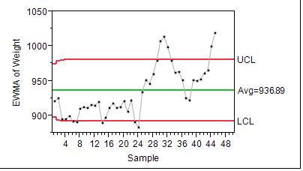
EWMA for Data of Example 6.7
<number>

Slide 24
Which charting was best?
The UWMA (or AMA) picked up a mean shift early on for spans of two or three.
The EWMA chart did not pick this up since it was a shift in process mean, not a trend.
Experience with the process is the best guide.
<number>

Slide 25
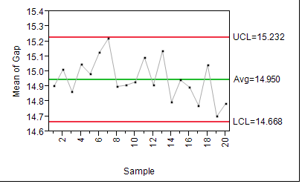
Another Example JMP Data set (there are 5 observations per subgroup but the UWMA and EWMA charts still work).
<number>

Slide 26
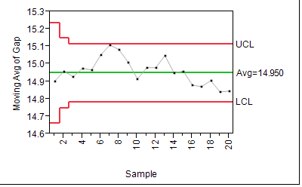
That was X-bar, now UWMA
<number>

Slide 27
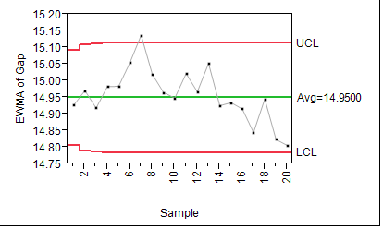
Now EWMA with r=.5
<number>

Slide 28
Why did the EWMA chart work?
Whenever there is trending, the most recent points have the most information.
The X-bar and R charts put all of the weight each on the most recent sample.
The UWMA charts weight each point equally in the span.
The EWMA chart weights the most recent signals with higher weights, this makes the signal to noise ratio the largest (largest signal gets most weight).
<number>

Slide 29
Caution!
If you graph your data every possible way you risk getting false signals!
People do that anyway but don’t be that guy!
<number>

